Slide 1


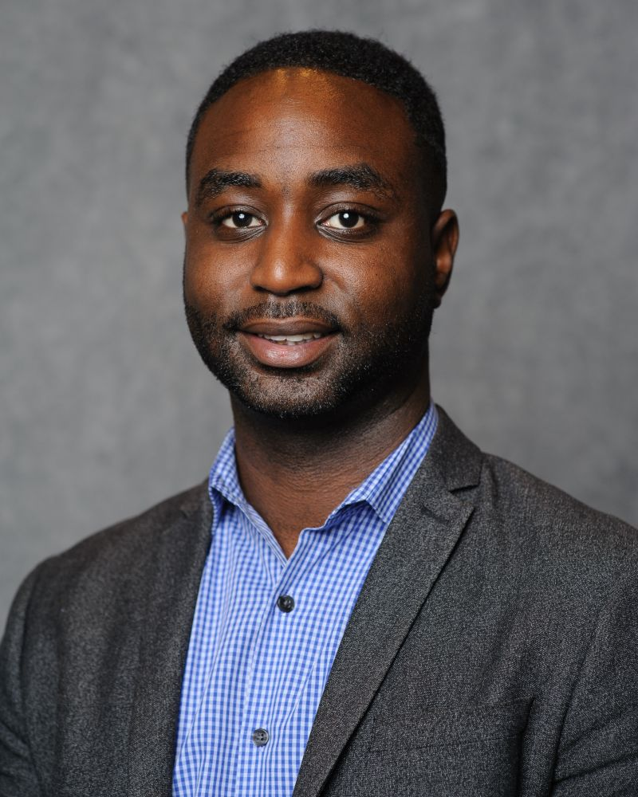
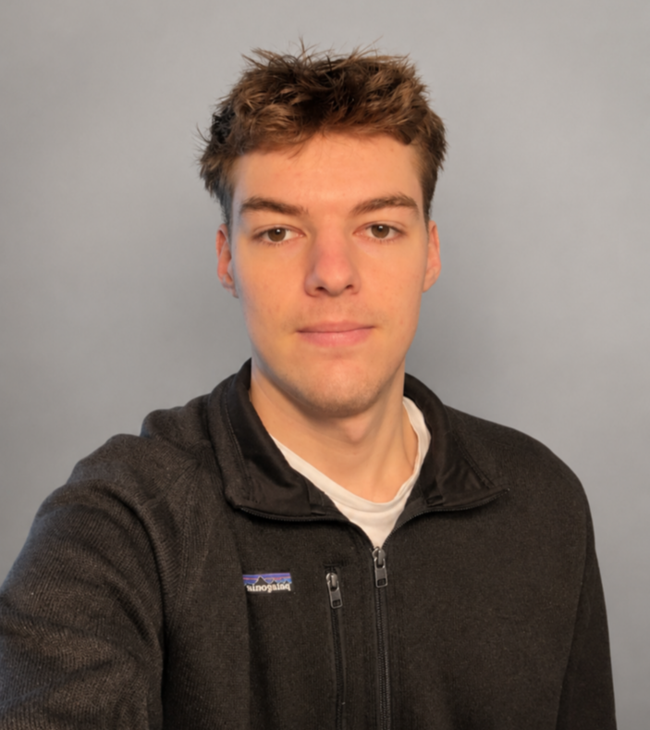
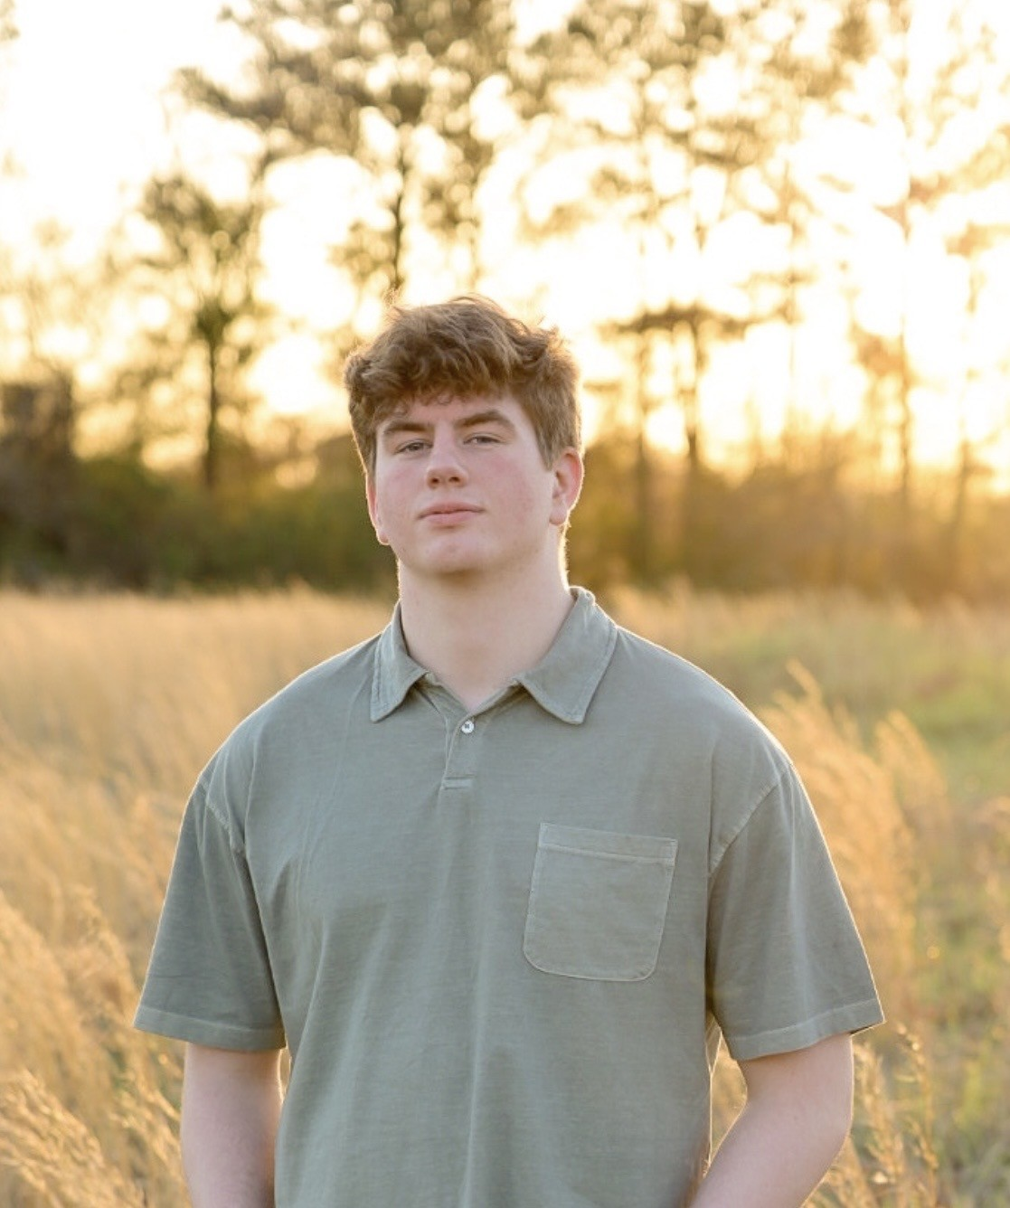
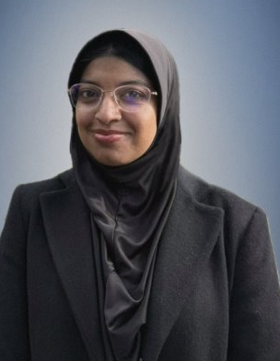
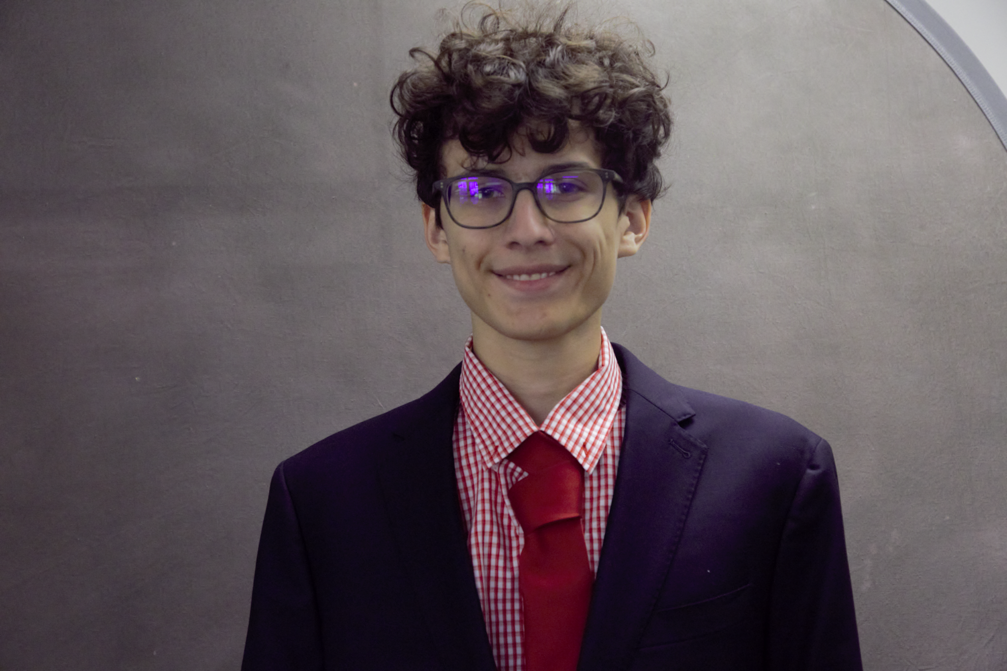
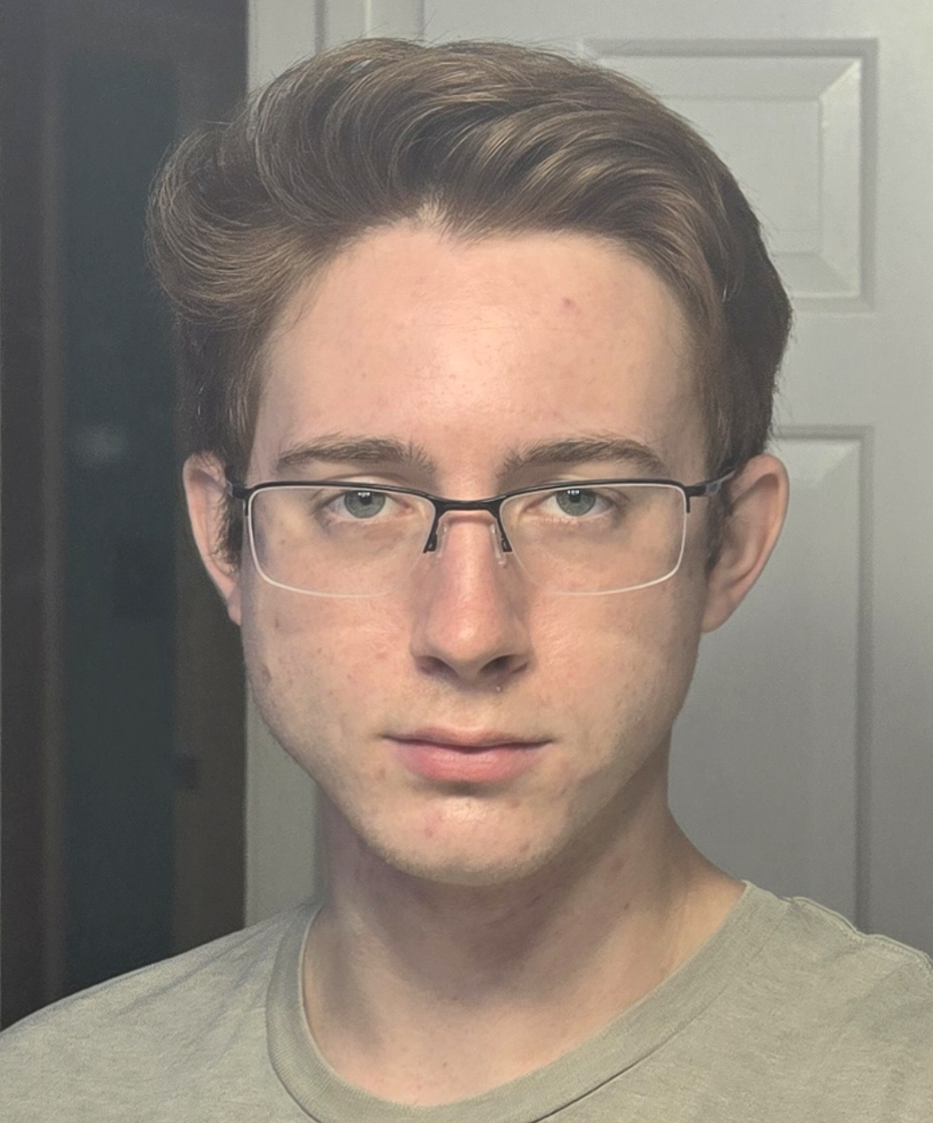
1
CS 495: Iteration 1 Presentation
Multi-User Physiological Computing
Dr. Chris Crawford
Trenton Ottman
Ansel Stinnett
Zara Ahmed
Jackson Wallace
James Adler
Speaker:
Everyone
Notes:
5 seconds

Slide 2
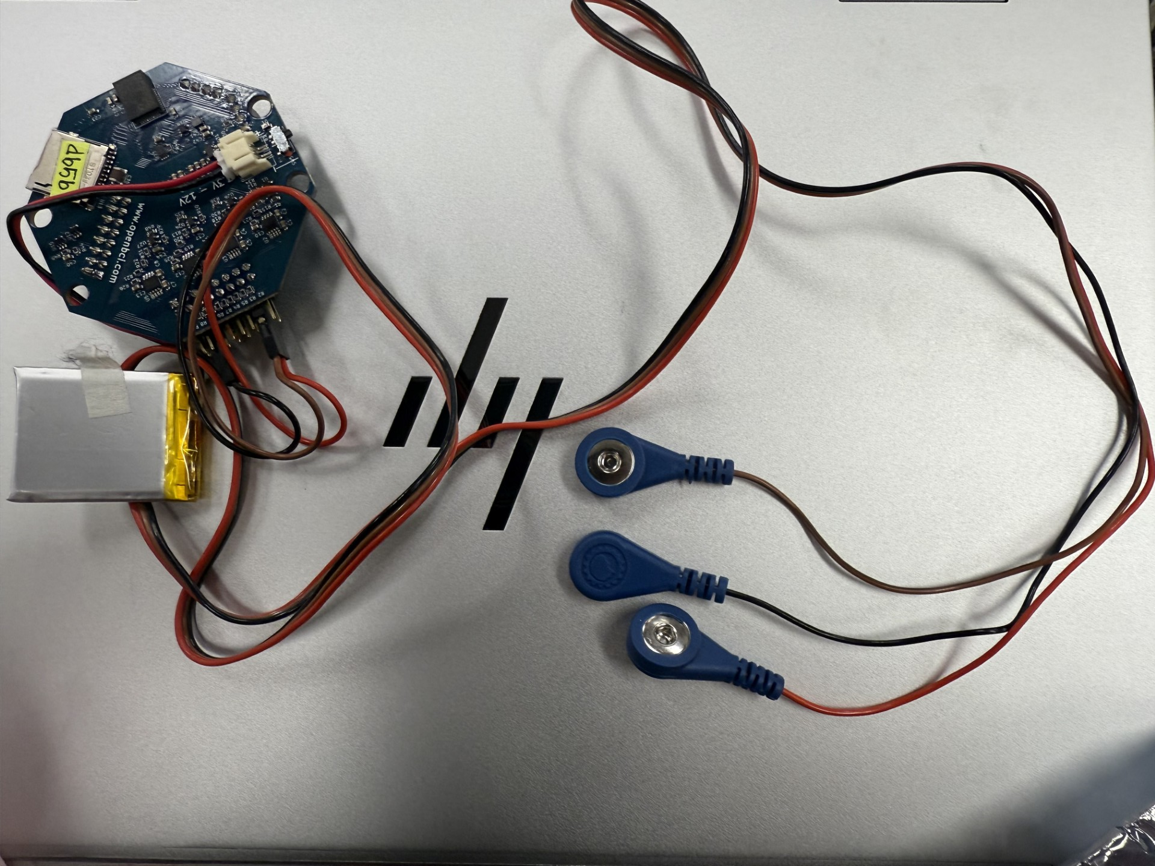
2
3
Project Review
Continuation of previous CS 495 project “PhysioGaming”.
Goal: Create a multiplayer game utilizing EMG sensors.
Iteration 1: Proof of concept multiplayer implementation.
Speaker:
James Adler
Notes:
Zara

Slide 3

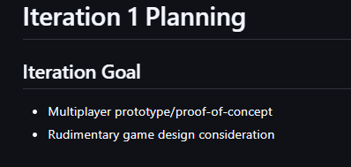
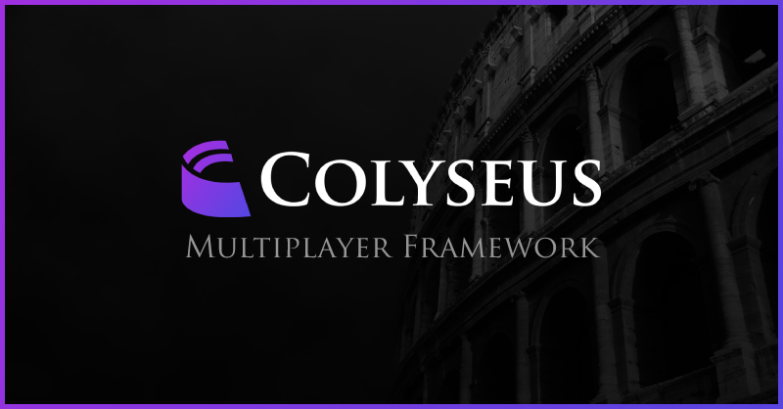
3
4
Planning & Actualizing
Highest priority: working multiplayer
Research game ideas, multiplayer options and game engines
Create an MVP of a playable multiplayer game
Decided to use Colyseus for multiplayer
Decided not to use Unity
Created MVP of pong for the demo
Speaker:
Jackson Wallace
Notes:
Trenton

Slide 4

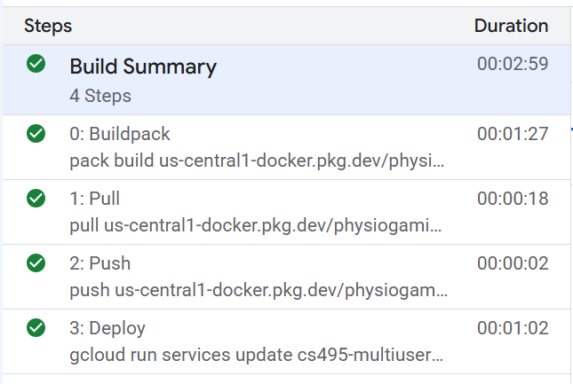
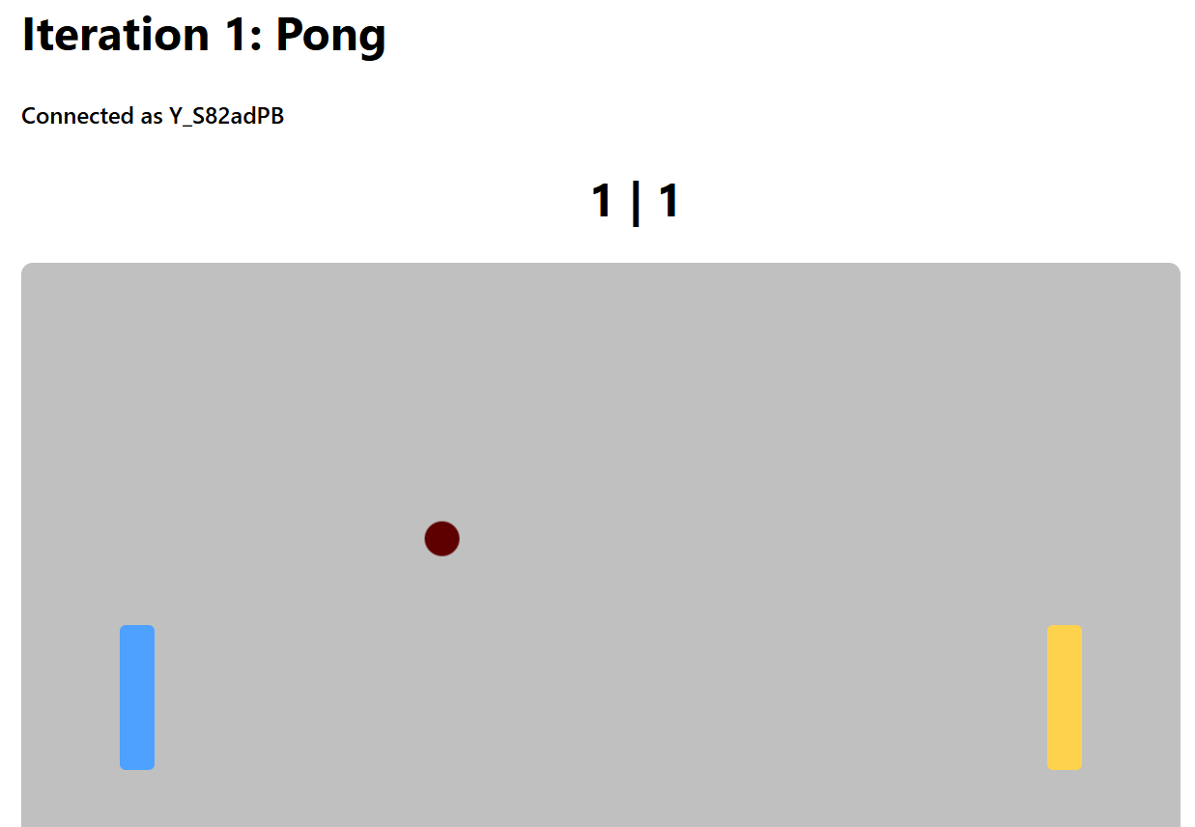
4
Major Accomplishments
Established team development practices
Initialized a Colyseus client/server architecture
Refactored the inherited repository to support our project's requirements
Built a working multiplayer prototype
Deployed the multiplayer server to Google Cloud
Speaker:
Trenton Ottman
Notes:
For sprint 1:
Decided:
- Will be a web app
- Will support 8-12 concurrent players in real time
Undecided:
- What networking tool will we use?
- What game engine will we develop on?
- How much of the previous project will we keep?
- Do we want to try and fix their machine learning gesture algorithm? (caused performance issues, target device is $200 chromebooks)

Slide 5
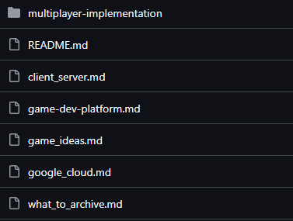
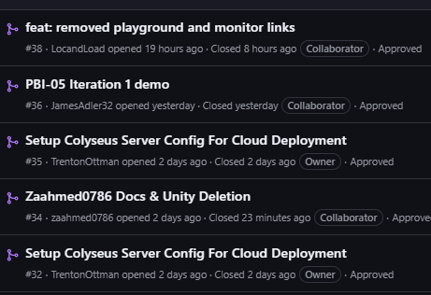
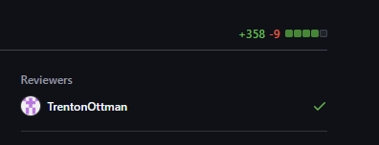

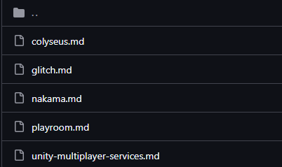
5
3
Engineering & Quality
Investigations
  Game Design Ideas
  Game Dev. platform
  Multiplayer implementation
Important PRs:
  Unity deletion & various docs
  Final demo
  Google Cloud
Limitations
  Security: Rate limiting & authentication
  Scope: Better to have a smaller working multiplayer game than a more ambitious failure
  Quality: Set up a mandatory review system for PRs
Speaker:
Zara Ahmed
Notes:
Zara

Slide 6
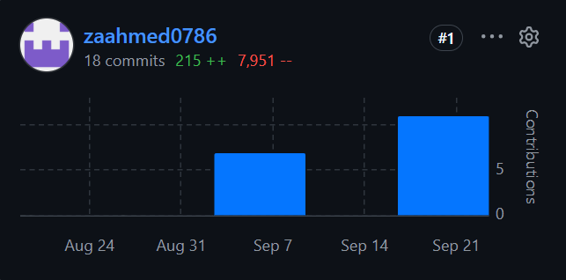
6
4
Team Contributions - Zara
Investigations for Glitch, Playroom, Unity, Godot, and 5 Game Design Ideas
Minor Unity training and eventual removal
Misc. documentation
Speaker:
Zara Ahmed

Slide 7
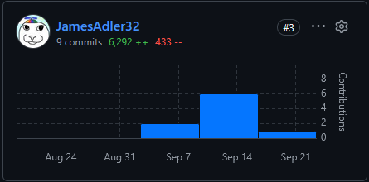
7
4
Team Contributions - James
Implemented the iteration 1 demo game
Investigations for Colyseus, Unity, and other potential multiplayer tech stacks
Misc. documentation
Speaker:
James Adler

Slide 8
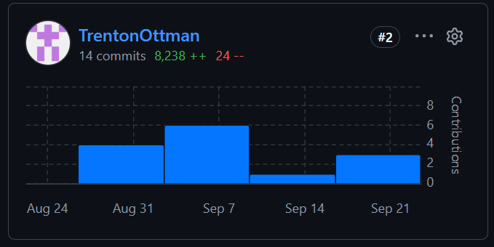
8
4
Team Contributions - Trenton
Investigations for Colyseus, Unity, and Google Cloud.
Set up Colyseus server configuration to work with a cloud deployment.
Deployed Colyseus server to the cloud.
Speaker:
Trenton Ottman

Slide 9
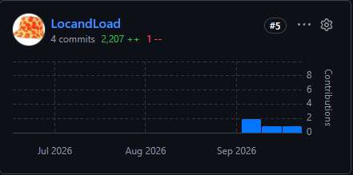
9
4
Team Contributions - Jackson
Investigation for authoritative server architecture
Archived and sifted through previous project files
Made progress towards using EMG sensor for input
Speaker:
Jackson Wallace

Slide 10
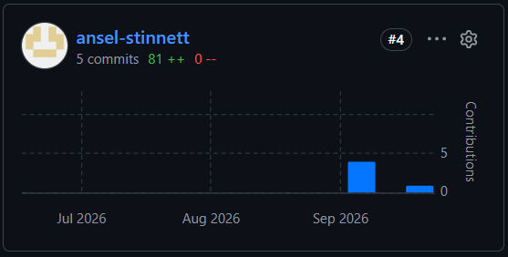
10
4
Team Contributions – Ansel
Reviewed previous team project to identify what we could reuse
Helped brainstorm game design ideas
Investigations for multiplayer approaches & scaling towards 8-12 players
Speaker:
Ansel Stinnett

Slide 11
11
Lessons Learned & Upcoming
Colyseus handles real time data sync and room support
Unity was disapproved of due to steep learning curve and sponsor's existing familiarity
  Rather use TypeScript frameworks
Built a simple pong multiplayer game to prove that multiplayer works before adding complexity later.
Iteration 2: Integrate EMG sensors into next game iteration and scale a game toward 8 – 12 players
Speaker:
Ansel Stinnett
Notes:
For sprint 1:
Decided:
- Will be a web app
- Will support 8-12 concurrent players in real time
Undecided:
- What networking tool will we use?
- What game engine will we develop on?
- How much of the previous project will we keep?
- Do we want to try and fix their machine learning gesture algorithm? (caused performance issues, target device is $200 chromebooks)

Slide 12
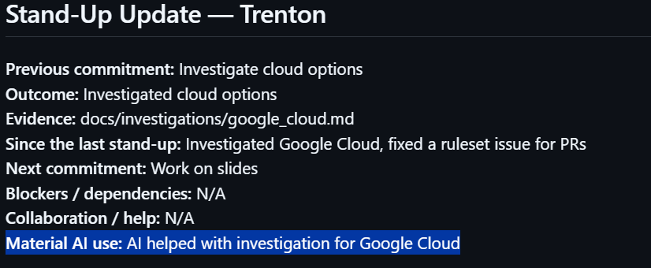
12
3
AI Usage
Investigations
Documentation
Code assists
Speaker:
James Adler
Notes:
Verified by checking over all output manually and cross references documentation when applicable. Furthermore, everything had to be reviewed when made into a PR.

Slide 13

1
Questions?
Notes:
10 seconds

